Slide 1

TEAM 11
Citadel Data Open West Coast Regional

Slide 2
Executive Summary
Data Exploration
Research Proposal
Modeling & Analysis
Conclusions
Appendix
Topic Question
Understanding the inter-temporal behavioral differences in movie reviewers, and how such traits may vary across different types of movies.
Background & Motivation
Summary of Analysis & Conclusions
Unlike the past century, competition in The Second Golden Age of television is met in both the cinema and on the small screen.
Customers are now more keen to “wait till it’s on Netflix,” or their preferred streaming platform rather than going to theaters. Factors like these result in a divergence in viewer profiles across time.
However, streaming platforms and Hollywood still have two distinct, primary goals.
Streaming platforms want titles that attract customers to their platform.
Hollywood wants titles that attract customers to the box office
Thus, as more platforms compete for people’s attention and screen time, movie ratings are playing an increasingly prominent role in determining people’s watch patterns.
How might we better understand the evolution of consumers’ perception of a movie following its release? Do temporal differences in consumer perception of movies vary across genres? Leveraging on these insights, can we predict whether a movie tends to grow on viewers over time, or receives an initial hype before quickly dying out?
In our research, we explore time-based trends between viewer’s general perception of movies in the months following a movie’s release.
In our research, we explored user rating data in-depth. Due to the Movie Lense dataset being vulnerable to frequency spikes during certain time periods, we chose to analyze ratings.
We analyzed every user’s rating pattern and a movie’s rating across
Model 2
Data Pipeline
Limitations of our analysis
Specific trends that we saw
Future Research Ideas
Notes:
In our feature engineering, we added movie metadata, rating information, and tags related to a movie’s contents to determine how ratings change over time

Slide 3
Executive Summary
Data Exploration
Research Proposal
Modeling & Analysis
Conclusions
Appendix
Dataset Usage & Data Wrangling
58098 rows x 3 columns (movieId, title, genres)
Dataset containing all movies for analysis, cross-referenced with ratings dataset using movieId; genre features were analyzed
title came in the form of "title (year)" e.g. Avengers, The (2012). Year was extracted and added to a new column release
title format did not correspond to other datasets e.g. Avengers, The would appear as The Avengers in movie_industry. This was resolved through string formatting prior to performing an inner join with movie_industry, so as to obtain industry metadata on selected movies. Similarly, foreign movies sometimes had both original language and translated names; such differences were also resolved through string formatting methods.
genres came in the form of “genre1|genre2|genre3…” as a string. One-hot encoding was done for all movies and genres, producing 16 binary columns representing genres.
We further subset movies which are released from 1996 onwards, since ratings data begin continuously from Jan 1996 (1995 has 1 month of data), and we are interested in the duration between movie release and rating.
movies.csv
movie_industry.csv
6820 rows x 15 columns (budget, name, etc…)
Dataset containing popular movies and industry metadata, used for feature exploration
ratings.csv
28M rows x 4 columns (userId, movieId, rating, timestamp)
Dataset with all ratings info together with timestamp
timestamps were converted from seconds since epoch to pandas datetime format for ease of timing comparison and grouping
genome-tags.csv
genome-scores.csv
tags: 1128 rows x 2 columns (tagId, itemId)
scores: 15M rows x 3 columns (movieId, tagId, relevance)

Slide 4
Executive Summary
Data Exploration
Research Proposal
Modeling & Analysis
Conclusions
Appendix
Feature Engineering
Ratings Dataset
With the ratings dataset, we engineered the following features: user_rating, months_delta
user_rating: the average rating given by the user throughout his movie ratings in the dataset (unique to each userId)
months_delta: the number of months elapsed from the timestamp of the movie’s first rating in the dataset until the timestamp of the rating (unique to each rating)
Movies Datasets
The ratings features were further grouped by months_delta for each movie, allowing us to calculate the mean monthly ratings of each movie
In a similar way, usermeanrating was produced as the monthly mean user_rating data for every movie, given the reviewers who reviewed that movie in that specific month
For movies in movie_industry, we calculated the profit margin of movies as (gross - budget / gross)
Tags Dataset
We noticed that the 1128 tags were not vastly different (e.g. “zombie”, “zombies”). As such we used principal component analysis to reduce the 1128 tags to 100 tags, retaining 80% of variance

Slide 5
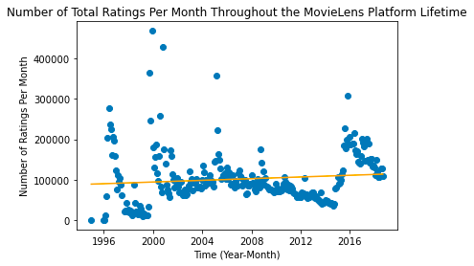
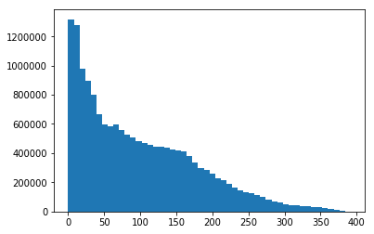
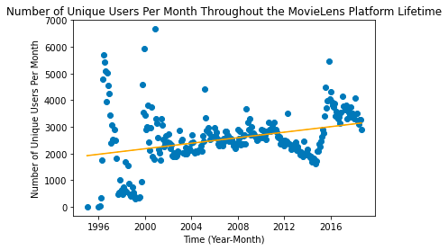
Executive Summary
Data Exploration
Research Proposal
Modeling & Analysis
Conclusions
Appendix
Exploratory Data Analysis
MovieLens Usage Trend
“Early Adopters, Late Majority, and Laggards”
Aggregate rating count after movie release date
We first began our data exploration by plotting rating information from the MovieLens dataset, as potential increasing trends (as the rating platform becomes more popular over time).
Seasonality or platform-specific spikes might skew our analysis pipeline. Noticeable during 1997, 2000, 2005, and 2016.
By plotting rating count and unique users per month over time and performing a simple linear regression, we conclude that there is no significant trend and cyclicality in terms of platform popularity and usage.
Rating count
Months after movie release
Using the release date information in movie_industry.csv, we created a subset of 4012 movies released after 1995. For this subset, we found 1,714,6188 corresponding ratings, and using their timestamp information, grouped them based on the months elapsed from the release date of their corresponding movie. The above histogram was then produced.
We were surprised to find that the ratings submitted within 1 year of a movie’s release did not constitute a significant majority of the entire database; instead, a notable percentage of consumers continued watching and reviewing movies many years after the movie’s release.
Based on this, we hypothesized that there may be differences in consumer behavior between early watchers and late watchers, which may potentially arise from contextual differences such as watching a movie in the cinema v.s. on TV/online, being a fan for a specific movie v.s. being a casual watcher.

Slide 6
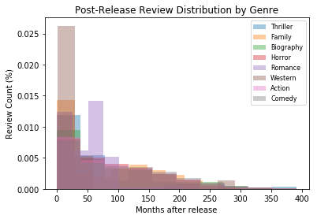
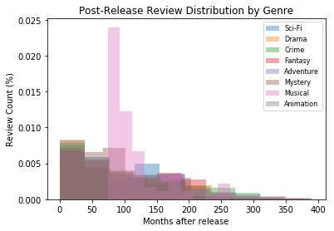
Executive Summary
Data Exploration
Research Proposal
Modeling & Analysis
Conclusions
Appendix
Exploratory Data Analysis
Cross-Genre Inter-temporal Differences
Following our general investigation on the time-series distribution of movie reviewers after the release date of a movie, we investigated how such distributions may differ across genres. Using the “genre” column in movie_industry, we classified ratings based on genres, and plotted the distribution density of 16 genres in the 2 plots below.
Through visual analysis, we can see that most genres get about <1% of their total ratings in the first 2 years of their release, with a gradual decline over the next ~10 years (240 months).
Interesting outliers include:
Western: 2.5% of total ratings are registered within the first 2 years of the movie’s release, followed by an immediate decline
Romance: Rating frequency peak at 1.5% after around 4 years of the movies release.
Musical: Rating frequency peak significantly at 2.5% after around 6 years from the movie’s release, with a gradual decline for 6 more years.
These outliers and trends may suggest that inter-temporal consumer behavior may vary across genres. For example, the abnormal frequency peak of the musicals genre may suggest that these movies have high rewatch value, and people do not mind watching them outside theaters.
Rating frequency
Rating frequency

Slide 7
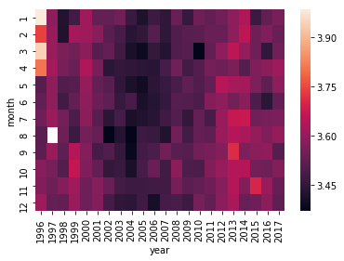
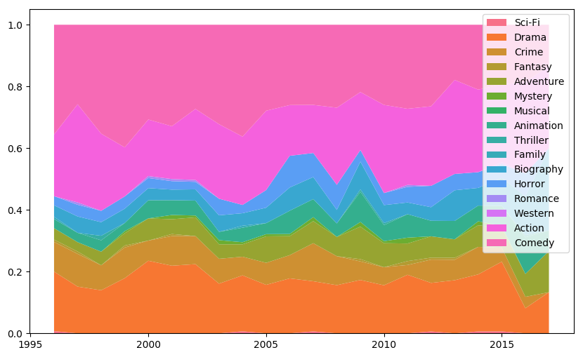
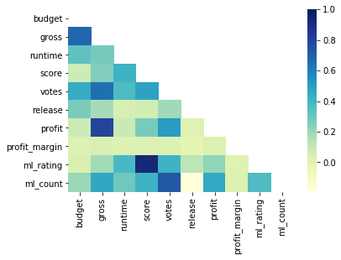
Executive Summary
Data Exploration
Research Proposal
Modeling & Analysis
Conclusions
Appendix
Exploratory Data Analysis
General Exploration
Average Monthly Rating over Time
Movie Category Trend
Movie Feature Correlation
Correlation
Average Rating
Genre Ratio
Release Year
To identify potential seasonality effects of consumer behavior within the span of our dataset, we plotted the above heat map and found that there is no clear seasonality trend across the years, apart from the minor observation that raters were slightly more critical between 2004 to 2007.
Given the genre data from movie_industry, we investigated the distribution of movie genres from 1996 to 2016. We see that comedy, action, and drama are the most frequent movies across all these years, with other genres consistently occupying a smaller percentage.
In understanding the various numeric features in both the MovieLens and movie industry datasets, we observed that the there is high correlation between the MovieLens average rating (ml_rating) and the score in the movie industry data. As such we decided to drop the average MovieLens score. Similarly, gross correlates highly with profit (an engineered feature) and budget, thus we decided to drop this feature too since it is already captured by profit and profit_margin.

Slide 8
Executive Summary
Data Exploration
Research Proposal
Modeling & Analysis
Conclusions
Appendix
Topic Question
Understanding the inter-temporal behavioral differences in movie reviewers, and how such traits may vary across different types of movies.
Firstly, we wish to understand how the general perception of a movie change over time. The key proxy for general perception is the average monthly rating of a movie. We hypothesize that two factors are associated with the monthly ratings of a movie:
Time elapsed between movie’s release and rating
We hypothesize that the characteristic of reviewers differ across time, leading to self-selection of rating types and biases.
For example, the consumers rating a movie within the first few months of its release may have always wanted to watch the movie since its announcement, or really enjoy the cinema experience, whereas consumers rating a movie many years after its release may only have stumbled upon the movie on Netflix, and/or viewed it on a smaller screen.
General profile of reviewers rating the movie in a given month
We hypothesize that the general profile of reviewers, that is how the average reviewer in a group rates an average movie, has a high impact on the monthly rating of the movie. This measures variability across different reviewer types.
Secondly, having gained initial insights from the impact of time on monthly movie ratings, we wish to further investigate whether such impacts might differ across movie categories and related features, such as genres.
We hypothesize that the inter-temporal impact of movie ratings differ across types of movies, and we explored if we could predict such trend differences using movie features.
For example, the initial ratings from a franchise-movie (e.g. MCU) might be abnormally high compared to the rest of its time-series data given initial hype and franchise perception, leading to a notable decline over time; in contrast, certain categories of movies may be considered “hidden gems”, and only gets popular after an initial dormant period, when it resurfaces on streaming platforms.

Slide 9
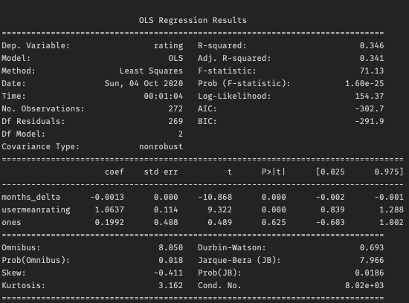
Executive Summary
Data Exploration
Research Proposal
Modeling & Analysis
Conclusions
Appendix
Model 1: Multiple Linear Regression to Predict Monthly Average Rating
Model Explanation
This example results shows that months_delta has a slight negative impact on monthly mean ratings, suggesting that the mean monthly ratings decreased over time
The >1 usermeanrating suggests that this particular movies is one which raters on average tend to rate higher than their usual rating behavior
The low p-values associated with both variables suggest high predictability of both factors
monthly mean rating of a specific movie
months_delta: number of months since the movie was first rated
usermeanrating: mean user rating across users who rated the movie in the given month
We used multiple linear regression to assess the impacts of two variables on the monthly mean rating of movies
We used this model for every movie in our movie dataset that was released during and after 1996, had at least 24 months of ratings data (since factors such as theatrical release, award shows are likely most evident within the first 12 months; our earlier rating count graph also showed that rating count began decreasing significantly after 24 months), and at least 500 ratings, using ordinary least squares
Example OLS results from one movie: Toy Story

Slide 10
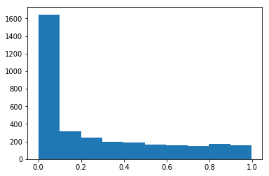
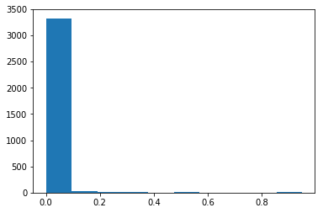
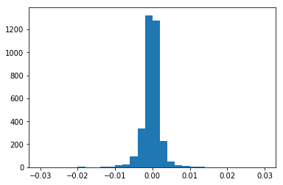
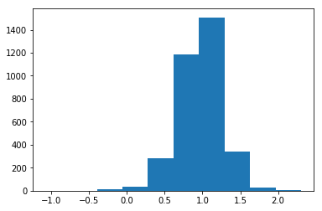
Executive Summary
Data Exploration
Research Proposal
Modeling & Analysis
Conclusions
Appendix
Model 1: Multiple Linear Regression to Predict Monthly Average Rating
Predictor: months_delta
Although each movie has a different set of months_delta data, varying from 24 months to 200+ months, we find that the p-value distribution of months_delta across these movies suggest that the latency of movie ratings do have a significant effect on the monthly mean ratings of a movie.
There is an almost even split on the direction of this impact, with a slightly negative skew.
This suggests that the monthly ratings of a movie tend to decrease, which might be explained by factors such as self-selection of early watchers, and the positive effect of cinema experience.
Nonetheless, the variability of these coefficients warrants further genre and feature based analysis.
Predictor: usermeanratings
The distribution of p-values from usermeanratings suggests that the average user rating across all movies given by users rating a specific movie in a month has a highly predictive impact on the monthly rating of that movie.
That the distribution of coefficients is largely positive and centered around 1.0 suggests that most movies in this subset are within user expectations, with some movies either exceeding or going below expectations.
p-value distribution for months_delta
p-value distribution for usermeanratings
Movie count
Movie count
p-value
p-value
Coefficient value distribution for months_delta
Coefficient value distribution for usermeanratings
Movie count
Movie count
Coefficient value
Coefficient value

Slide 11
Executive Summary
Data Exploration
Research Proposal
Modeling & Analysis
Conclusions
Appendix
Model 2: Predicting Total Movie Rating Variability Over Time
Model Pipeline Overview
Feature Engineering
Neural Network Training
Model Evaluation
PCA of 1,128 genome tag relevancy scores into 100 features
Data wrangling of additional industry metadata features for movies
Neural network training using movie features as predictors and polynomial features as target variables
Out of sample neural network testing
Neural network accuracy evaluation
Polynomial regression of monthly average ratings over time
Identification of polynomial features
Target Variable Engineering

Slide 12
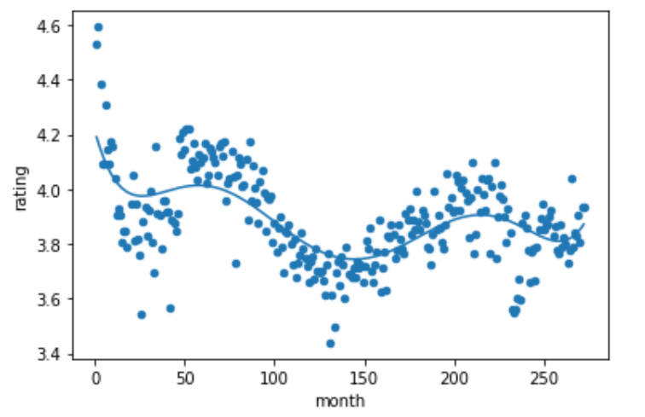
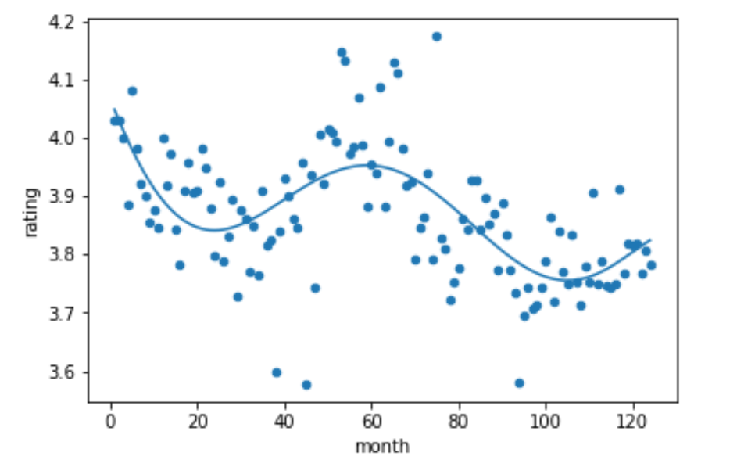
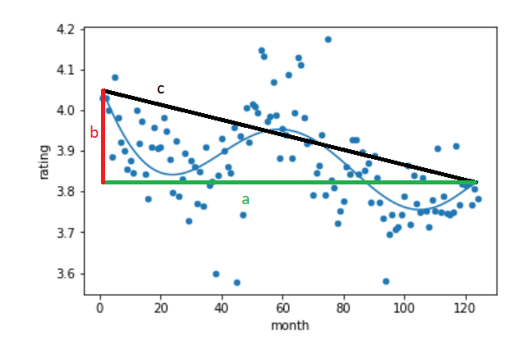
Executive Summary
Data Exploration
Research Proposal
Modeling & Analysis
Conclusions
Appendix
Model 2: Predicting Total Movie Rating Variability Over Time
Step 1: Feature Engineering
When investigating average movie ratings as a function of time, we found some intriguing relationships. We contemplated several ways of quantifying the shape of the relationship, including the degree of the polynomial that best fit the data (using regularized linear regression), the total variation in the ratings over time, the location of extrema, average months between extrema, etc.
We decided that the two best ways to capture the intricate relationships in our data are to compute the total variation in the function that best fit the data, as well as the net rating change over time. Because we calculated both of these metrics using the fit polynomial, they are insulated against random variation. We dismissed other metrics due to various issues with each of them.
We fit the ratings data for each movie with a sixth degree polynomial to capture as much of the relationship as possible without overfitting. We chose degree six because we consistently found, visually, that the polynomial relationship between ratings and time did not exceed this degree.
We identified two key metrics (target variables) to identify the features of our fitted polynomials:
Monthly ratings over time for Iron Man
Monthly ratings over time for Toy Story
Feature | Metric | Intuition
Monthly Rating Variation over Time | Arc length of polynomial within a specified month range | Characterizes the volatility of consumers’ perception towards a movie over time
Long Term Rating Trend | f(n) - f(1), where f is the fit polynomial | Characterizes the direction and magnitude of change in consumers’ perception towards a movie over time
In the sample graph above, b denotes our metric for long term rating trend
Formula for polynomial arc length

Slide 13
Executive Summary
Data Exploration
Research Proposal
Modeling & Analysis
Conclusions
Appendix
Model 2: Predicting Total Movie Rating Variability Over Time
Step 2: Artificial Neural Network
With the two target variables identified, we chose a number of movie features from both the genome tag database and movie industry metadata database as predictors.
Our predictor variables are:
Industry metadata: Budget, profit margin, score, votes, runtime, release year, profit
Genome tag data: 100 principle components generated from 1,128 genome tags
In particular, we dropped gross revenue and MovieLens net ratings due to high correlation with budget and movie industry ratings respectively. We also dropped categorical data such as writer, director, star actors, and production company due to high variability across movies. We also dropped features, such as country, that intuitively would not produce any predictivity.
We ran two neural networks for each time frame; one for rating variation and one for net rating change. Our time frames ranged from 4 months, 12 months, 24 months, and 90 months after the movie’s release. That is, we ran our models while considering months between a movie’s release month and 4 months after release, between a movie’s release month and 12 months after release, etc.

Slide 14
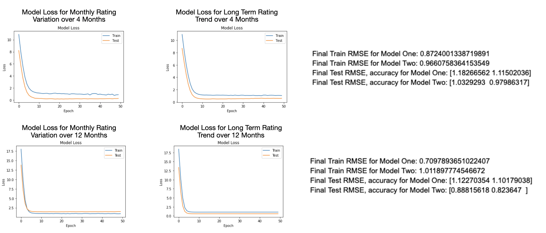
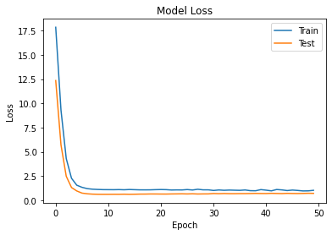
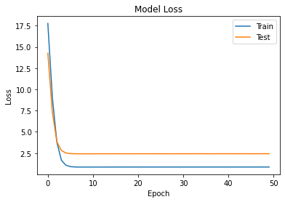
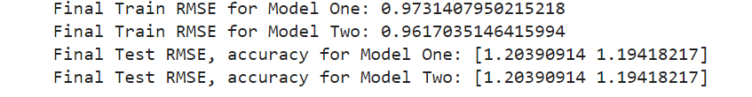
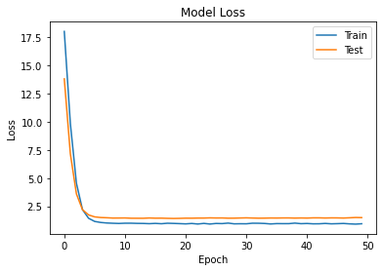
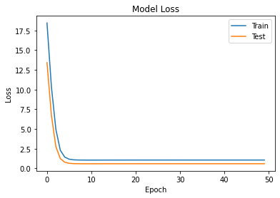
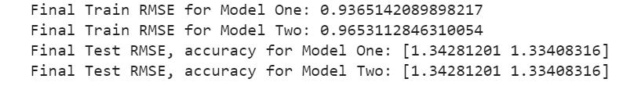
Executive Summary
Data Exploration
Research Proposal
Modeling & Analysis
Conclusions
Appendix
Model 2: Predicting Total Movie Rating Variability Over Time
Results (4 months & 12 months)
For both 4 months and 12 months timeframes, our models losses converge at around 10 epochs.
The root mean square error (RMSE) values reported are in number of standard deviations away from the true value that our models deviate from.
Model Loss for Monthly Rating Variation over 4 Months
Model Loss for Long Term Rating Trend over 4 Months
Model Loss for Monthly Rating Variation over 12 Months
Model Loss for Long Term Rating Trend over 12 Months

Slide 15
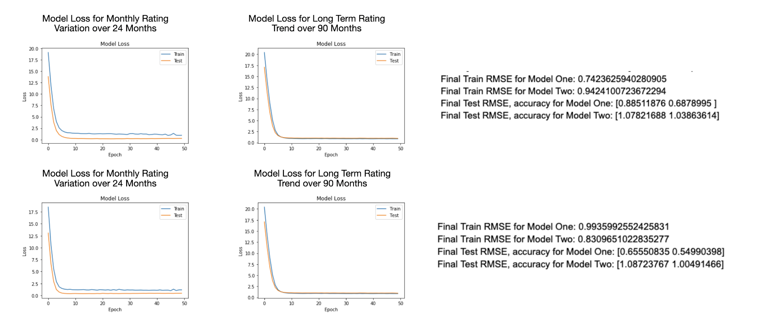
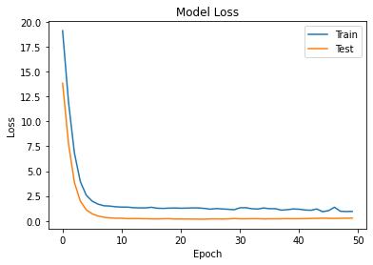
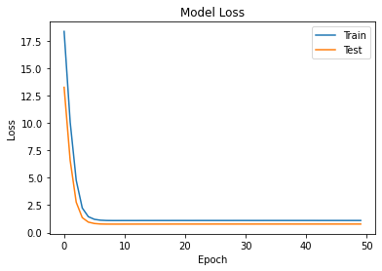
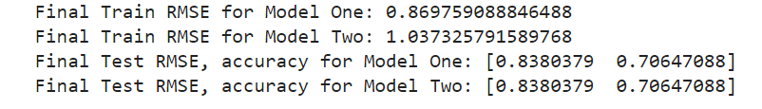

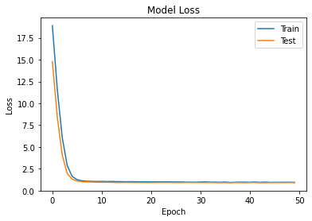
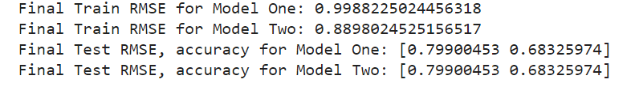
Executive Summary
Data Exploration
Research Proposal
Modeling & Analysis
Conclusions
Appendix
Model 2: Predicting Total Movie Rating Variability Over Time
Results (24 months & 90 months)
For both 24 months and 60 months timeframes, our model loss also converge at around 5 epochs.
Although the RMSE values are still near 1 standard deviation, we can see a slight trend in that the model accuracy increases as we increase the timeframe to a longer-period.
Model Loss for Monthly Rating Variation over 24 Months
Model Loss for Long Term Rating Trend over 60 Months
Model Loss for Monthly Rating Variation over 24 Months
Model Loss for Long Term Rating Trend over 60 Months

Slide 16
Executive Summary
Data Exploration
Research Proposal
Modeling & Analysis
Conclusions
Appendix
Model 2: Predicting Total Movie Rating Variability Over Time
Conclusions
As a whole, our artificial neural network model is able to make relatively weak predictions (< 1 standard deviations) for both the rating variability of movies over time and net rating change over time using features including profit margin, runtime, release year, and subject tags.
However, a trend we observed through varying the time frame length is that the rating variation model performed significantly better as we increased the timeframe from ~1 year to ~8 years, suggesting that the features are more predictive of a movie’s long term rating variability as opposed to a short period after a movie’s release.
The features inputted to our model was movie metadata (e.g. budget, genre, tags, etc.). Given the high amount of diversity between movies, our model indicates that features that are specific to the movie itself will create a more accurate model. This movie-specific data includes but is not limited to: caption transcripts, plot summaries, and written critic reviews. In addition, understanding the breakdown of specific metadata could uncover important trends. For instance, understanding the marketing sub-portion of budgets or the sub-genres of movies could substantially increase our model’s accuracy.
Our model performs better in a longer timeframe. In addition to our observation from Model 1 (model for predicting monthly average rating, slide 9) that movies tend to have lower ratings later in their timeframe, we can conclude that raters tend to prefer newer movies, possibly due to better visual quality or relatability.

Slide 17
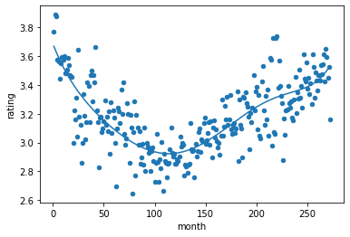
Executive Summary
Data Exploration
Research Proposal
Modeling & Analysis
Conclusions
Appendix
Model 2: Predicting Total Movie Rating Variability Over Time
Key Insights
We showed that there were distinct and significant trends in the relationship between a movie’s ratings and the time elapsed since its release.
Our features were unable to capture why these trends exist, but other features we did not use may be able to predict them well.
Given a model that can accurately predict rating variability over time and net rating change over time, we can derive additional insights. Such a model can be used to advise decision-making for streaming platforms, such as identifying types of movies that gain renewed interest among consumers over the long-term, and the consistency of consumer perceptions over time. The model can also be used to understand consumer behavior towards movies, predicting the self-selection of viewer types as a function of elapsed time.
For Hollywood Production movies, where the most profitable and largest means of revenue is box office revenue, high initial ratings is an important indicator of box office revenue. Since we concluded that newer movies recieve higher ratings than older movies, a possibly lucrative decision for production firms is to prioritize an increased quantity over quality of movies given the same budget. This operating strategy is similar to India’s “Bollywood”, where nearly 4x more movies are produced compared to Hollywood.
We see a distinct shape in this graph for ratings over time for Jumanji. This relationship exemplifies many such relationships we saw for individual movies.
Notes:
Second, our model fits better for the longer timeframe. In combination with the observed decrease in ratings over time (Model 1), it clearly indicates that newer movies have an observed higher rating to viewers. Thus, we conclude that a decision for a production firm to prioritize the quantity of movies made rather than the quality may boost total box office sales, similar to the Indian Bollywood movie industry.

Slide 18
Executive Summary
Data Exploration
Research Proposal
Modeling & Analysis
Conclusions
Appendix
Model 2: Predicting Total Movie Rating Variability Over Time
Future Research
One obstacle we faced is the size of our dataset. Although we began with ~58,000 movies with user ratings, only ~33,000 movies were released after 1996 (when the ratings began), ~13,000 movies had genome tag relevancy scores, and ~7,000 movies had industry metadata. Ultimately, our usable dataset post-wrangling and merging was scaled down to ~4,000 movies, which hindered our analysis.
For further analysis, we could scrape more industry metadata to increase the number of features in our dataset, which would yield greater predictivity.

Slide 19
Executive Summary
Data Exploration
Research Proposal
Modeling & Analysis
Conclusions
Appendix
Monthly Average Rating Across Movies
Across various category and types of movies, we found that the time elapsed since the release of a given movie has a high predictability for the movie’s monthly average ratings. Similarly, the rating profile of viewers in that given month is also a predictive factor.
Interestingly, there is an even split between the positive and negative effects of the time elapsed variable, suggesting that some movies have higher monthly rating over time, while some have lower monthly rating over time.
Predicting Monthly Rating Trend Using Movie Features
We created an artificial neural network model aimed at predicting monthly rating trends based on movie features, which was able to make weak predictions within 1 standard deviation. This suggest a degree of predictability between movie features and rating trends such as variability and general perception change.
In particular, we found that predictability increased slightly when we increase our time horizon, suggesting that such a prediction model is more accurate in determining long-term trends.

Slide 20
Executive Summary
Data Exploration
Research Proposal
Modeling & Analysis
Conclusions
Appendix
Future Application of Research: Netflix/Oscar Effect
We also attempted to investigate the phenomenon known as the “Intervention Effect”, where viewership of movies drastically changes when an event brings certain movies to the spotlight, such as a movie being released on a streaming platform or a particular actor being nominated for an award. For example, this is observed when a movie from long ago is reintroduced on Netflix, resulting in a huge spike in viewers and reviews for that movie overall.
Although this idea initially sounded promising, after working with the provided datasets and supplemental Netflix datasets, we realized that we did not have sufficient data to work with as the intersection between the Netflix dataset and our overall dataset was very small (<1,000), especially after considering normalization factors arising from the timeframe of our ratings dataset. A similar issue arose when considering the Oscar dataset.
Furthermore, for the “Oscar Effect”, we felt that the one-year timeframe between a movie’s release and an Oscar nomination event further limits the ratings data for a pre-post comparison. This initial observation then motivated us to consider a longer timeframe, hence our main research topic.

